Slide 1
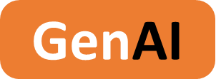

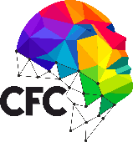
VisionAI Describer 2024 - 2025
AI-Powered Image Insights from Drive

Slide 2
Project Name
GenAI Boot Camp April / May 2025
Team Information
Sri Abirami. N
Kavitha. P
Aruna. KK
Bharathkumar. R
Student Team
III - BE, Biomedical Engineering
SNS College of Technology
Developer
III - BE, Biomedical Engineering
SNS College of Technology
Developer
III - BE, Computer science & Engineering
SNS College of Technology
Developer
III - BE, Computer science & Engineering
SNS College of Technology
Developer
Gurumoorthi. S
Bhuvaneshwari
III - BE, Computer science & Engineering
SNS College of Technology
Developer
DT Mentor
Faculty

Slide 3
Project Name
GenAI Boot Camp April / May 2025
Project Overview
Problem statement
People often store images on Google Drive but lack tools to instantly understand the content or context of those images. Manual review is time-consuming, especially for users with visual impairments, educational use cases, or data tagging needs.
Description
This project uses a chatbot integrated with agentic AI to automatically retrieve an image from Google Drive and generate a description. The system enhances accessibility and productivity by giving instant image context. It can support education, content curation, and digital asset management.
Scope
GenAI | Agentic AI
1.The workflow is built using n8n, connecting a Google Drive node, an agentic AI model for image captioning, and a chatbot output module.
2.The system supports real-time file input from Drive, auto-download, analysis, and conversational delivery of insights. The project emphasizes seamless integration and user-friendly output.
1. n8n.io , Google Drive Node, Image Captioning Agent, Google Gemini Chat Model, Trigger Node
Key factors & features
Target Audience
Ideal Customer Profile
Automatically fetches images from Google Drive, Describes content in natural language, Offline/local agentic AI support, Extensible for accessibility tools and image tagging, Can be adapted for bulk image processing.
Students and educators, Visually impaired users, Social media managers, Digital archivists and photo collectors, Developers working on smart assistants.
Schools and EdTech platforms, NGOs working in accessibility tech, Research labs and content tagging teams, Photo management startups.

Slide 4
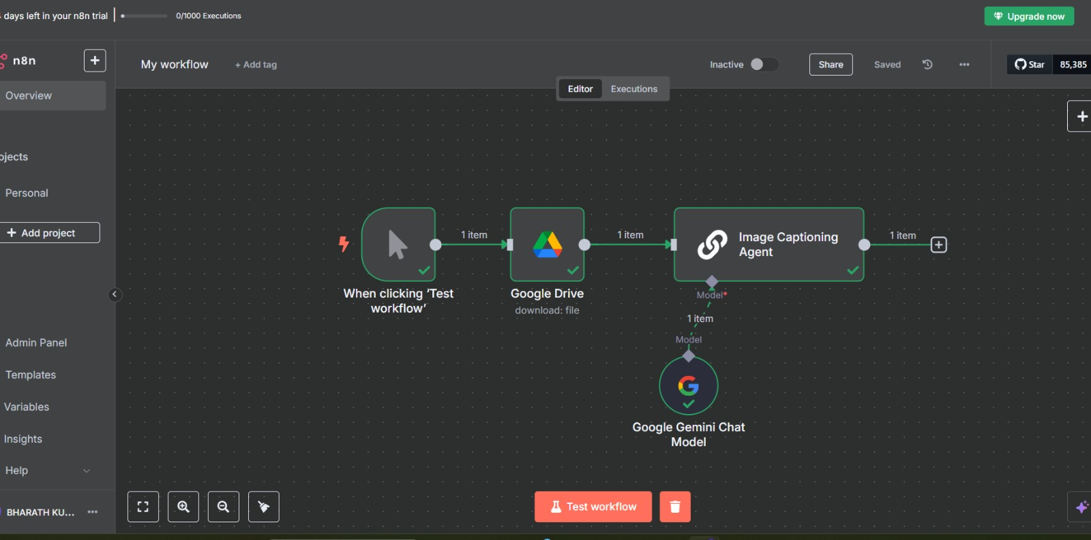
Project Name
GenAI Boot Camp April / May 2025
Application Screenshots
Application Screenshots

Slide 5
Project Name
GenAI Boot Camp April / May 2025
Thanks
Thanks

